Slide 1

Welcome to
© Jigsaw PSHE Ltd

Slide 2
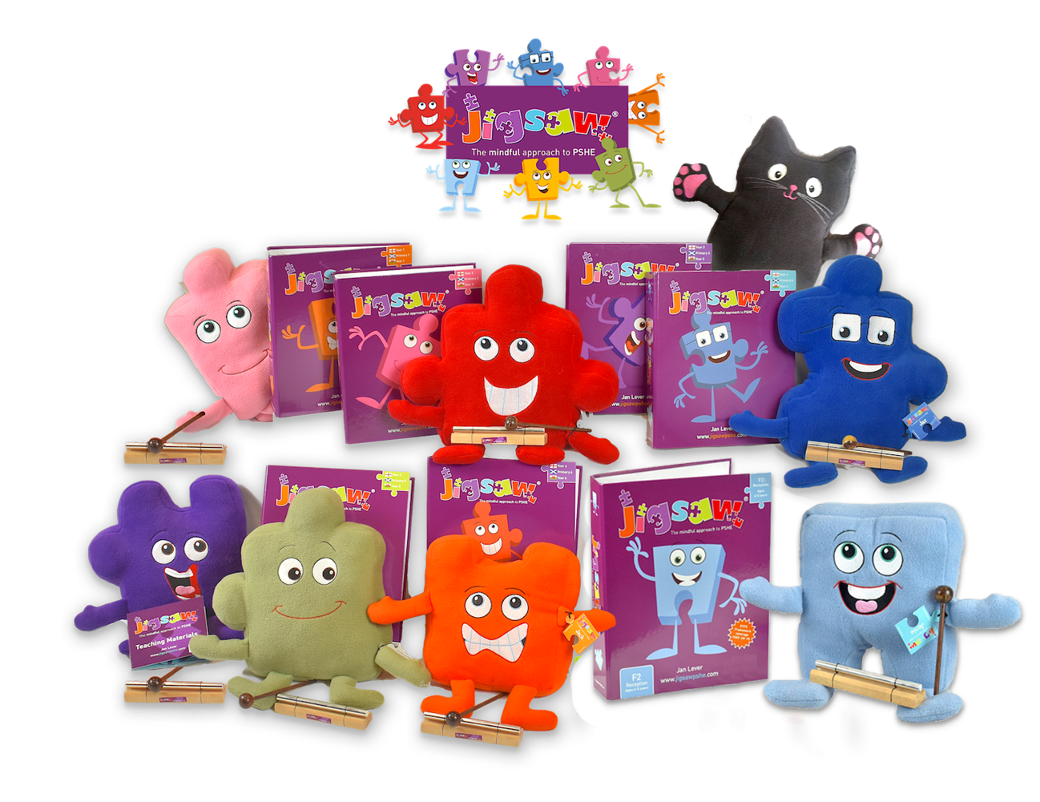
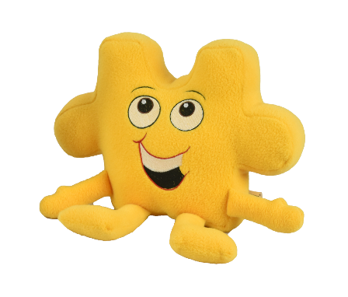
We are your new Jigsaw friends!
© Jigsaw PSHE Ltd

Slide 3
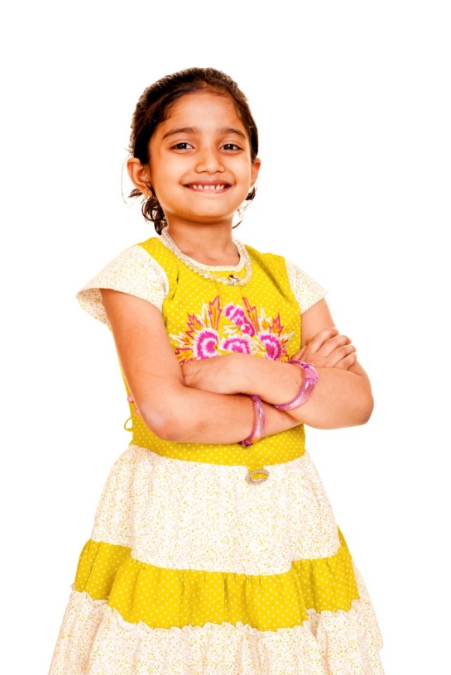
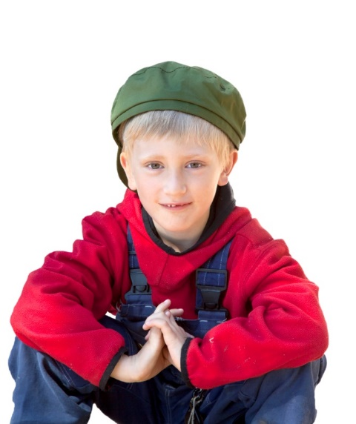
We are going to have lots of fun together!
We are going to help you learn all about PSHE
That’s about you as a person,
how you get on with other people,
how to stay healthy,
and lots more to keep you safe
and help you learn.
© Jigsaw PSHE Ltd

Slide 4
Together we are going to solve 6 Puzzles
Being Me in My World
Celebrating Difference
Dreams and Goals
Healthy Me
Relationships
Changing Me
We will explore one each half term.
© Jigsaw PSHE Ltd

Slide 5
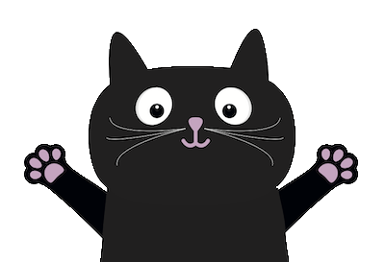
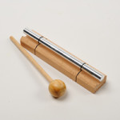
We are also going to teach you how to feel calm
and think about things
more mindfully.
© Jigsaw PSHE Ltd

Slide 6
I’m Jino, I can’t wait to meet all the children in my class.
© Jigsaw PSHE Ltd

Slide 7
I’m Jigsaw Jaz, we’ll be tackling some tricky topics together.
© Jigsaw PSHE Ltd

Slide 8
I’m Jigsaw Jez. I’d like to say hello to all the children in my class.
© Jigsaw PSHE Ltd

Slide 9
I’m Jigsaw Jem, I will be working with some of the older children in school.
© Jigsaw PSHE Ltd

Slide 10
Don’t forget about me! I’m Jigsaw Jerrie Cat and I’ll help teach you mindfulness.
© Jigsaw PSHE Ltd

Slide 11
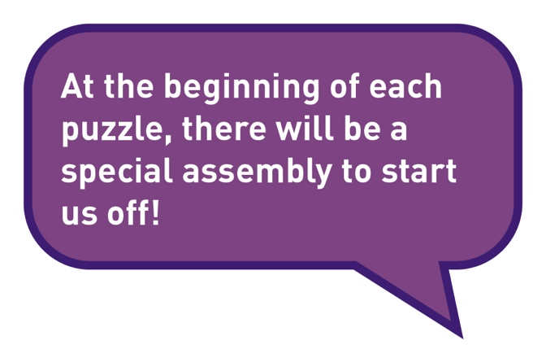
© Jigsaw PSHE Ltd

Slide 12
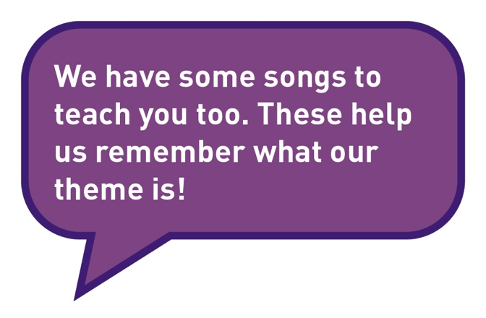
What else?
© Jigsaw PSHE Ltd

Slide 13
Your lessons will have different parts
The Jigsaw Charter will help you feel safe and respected.
Connect Us is when you will play some games.
Calm Me time will help you relax and manage your feelings.
© Jigsaw PSHE Ltd

Slide 14
Your lessons will have different parts!
Open My Mind will focus your thoughts on the lesson topic.
Tell Me or Show Me is when you will be taught new skills and information.
Let Me Learn is where you will have a chance to put these into practice.
Help Me Reflect is when you will be able to think about how you feel about your learning and your progress.
© Jigsaw PSHE Ltd

