Slide 1
COMPUTER MISUSE ACT
PARENT GUIDE
Notes:
Introduce yourself to the audience
Explain that you are here to
Talk about the Computer Misuse Act. This is because children sometimes unknowingly (& sometimes willingly) break this legislation and find themselves in very deep waters
Help you to understand the tools & techniques children use to hack & commit offences.

Slide 2
CMA - PART 1 - UNAUTHORISED ACCESS
When a student knows someone else's credentials so they log into their. . .
Computer or Phone
SnapChat or TickTok account
Or they log onto their own computer & find
Files that aren’t theirs
Software that is not for them.
Notes:
Use this slide to explain that the first part of the Computer Misuse Act involves accessing someone else’s digital devices without their permission.
By digital device we mean laptops, desktops, iPad or even a mobile phone.

Slide 3
GUESS THE PUNISHMENT(!)
Is it :
A letter from the police
A £500 fine
A £5000 fine
6 months in prison
1 yr
2 yr &/or a £5,000 fine
Notes:
So, what do we think? What would be the maximum punishment . . . if we were over 18? Is it . . .
Run through each bullet point & give parents 20 seconds to discuss in pairs. By show of hands, collect responses.
The answer is 2 year’s. You may also get a fine that cannot exceed £5,000
Shocking?
It depends on how access was gained & what computer was accessed.
A police officer that abuses his position of trust to access a database with critically sensitive data on it may well get a 2 year sentence.
A student hacking his best friend’s account, however, might be looking at that letter – which isn’t very nice – trust me!

Slide 4
UNAUTHORISED ACCESS & ABUSE!
Perhaps you
Delete or Change stuff
Plant a virus or a worm
Encrypt data (scramble it)
Hijack a web cam
Kick a best mate off a gaming platform
Transfer money into their account
Notes:
The second part of the Computer Misuse Act, involves not only accessing stuff without permission but doing something bad.
Some people do this because they really don’t know they are breaking the law.
Others do it because they are not nice or think they won’t get caught!
Perhaps you . . .
Run through each bullet & add emphasis where possible.

Slide 5
GUESS THE PUNISHMENT!
Is it :
1 Yr Imprisonment
3
5
7
10 Yrs imprisonment
Notes:
So, what do you think? If you are over 18, what would the maximum punishment be
Run through each bullet point & give students 20 seconds to discuss in pairs. By show of hands, collect the responses.

Slide 6
WHY SO HARSH!!
What happens to
Students work?
Teachers Work?
How students are doing
Where they are?
Medicines?
Contacting you?
Paying bills?
Fines worth millions!
Notes:
The answer is 10 years but again it depends on what you did.
Lets say, you planted ransomware on the schools computers which encrypts everything (i.e. scrambles all the data).
How would your school cope?
Any work you’ve done on the computers is gone.
Any activity sheets or PowerPoints the teachers use have gone.
All the grades and reports about how students are doing are gone.
In fact, how does the school know who is in what classroom, who needs what medicines, or how to get in touch with parents if there’s an emergency?
How does the school pay for the electricity, gas, food or other educational resources it uses?
How does it pay staff or run the canteen?
And if a school loses the private data on you they have to pay millions of pounds in damages.
And what is true of a school is true of a business – businesses collapse when they lose customer data and employees end up losing their jobs!
And if you can imagine the heartache and suffering that hacking causes, you’d understand why 5 years can sometimes be perfectly reasonable.
What happens if you play with a computer that protect people’s well being and safety and someone got hurt?
Perhaps they can think of an example where people’s lives depend on computers (e.g. the NHS or aviation)

Slide 7
WHO AM I
I am not necessarily
Motivated by money
Holding a grudge
Thinking about politics
Gifted & Talented
Autistic
Anti-social or involved in criminal activity
See what I am doing is wrong
Notes:
Because of the paucity of research into cyber criminality, we are often at lost to describe the typical profile of a young offender.
Run through each bullet point.
NB:
There is some interesting research at the moment regarding possible connections between autism & hacking. Sometimes, these children are socially isolated and find solace in computing. Sometimes, the logic of a digital device, coupled with the difficult of trying to understand what is morally acceptable – presents challenges for these children that make it more likely that they may end up on the wrong side of the law.
Not because these children are any more naughty, but that sometimes
And yet, teenage cyber criminals can display all of these traits.
It seems to me, however, that there are 2 critically important facets to cyber dependent crime
Teenagers love the idea of being able to hack. It gives them a certain amount of kudos that is hard to get elsewhere. It is also the automatic badge of honour for being technically gifted and an elite programmer – even if this is not the case.
Secondly, there is an enormous sense of self gratification when your exploit kit works. It is the thrill of committing a crime without the fear that you will be identified and reprimanded. That there is far less chance of you being caught sat behind your computer in the safety of your own bedroom then being identified on CCTV or caught red-handed in your local Curry’s store having smashed up all the electronic stuff.
[CLICK]
And finally - and perhaps most worryingly – it is the misconception that actions are without consequences. That there are no ‘victims’ in a cyber attack. I wonder how many children know that planting malware on a hospital database or just launching a DDoS attack against the wrong type of server can earn you life imprisonment and a £5000 fine for endangering lives or putting important communication platforms at risk.
When personal data gets leaked, companies are investigated, people lose their job and thousands of pounds – and sometimes millions - are lost in revenue and reputation.

Slide 8
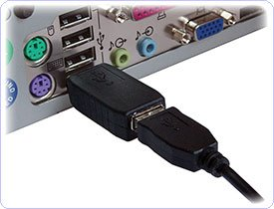
NETWORK INTRUSION
THE BIG No-Nos
1. Key Grabber
£20 Amazon
Ultra compact. Only 38 mm
Record 10,000 pages
2. The Rubber Ducky & Bash Bunny
Cheap
Multiple Payloads
3. The Pineapple Wi-Fi
Automatic Connection
Everything is Visible
Notes:
With a little bit of technical know-how, it’s easy to hack.
[Using the bullet points, explain how a key grabber works:
They are cheap, freely available and hard to detect.
You plug your keyboard cable into it and then the whole thing goes into the back of the computer, whereupon it records anything you type – like your username and password]
[Ask the audience:
How many of you check the back of computers whilst at work?
How many of you would think twice even if you saw it?
How long do you think it would take a kid to plant in a school environment?
There are more advanced USB drives too.
[Using the bullet points, explain:
A Rubber Ducky can be purchased for £20-40 & a Bash Bunny for £50-90.
A pen tester would drop one of these on the playground if they wanted to test the school’s security.
Why?
Because what kid wouldn’t pick one these up and plug it in?
Strike that – what teacher wouldn’t pick it up and plug it in, thinking someone had lost it?
However, as soon as you do, the USB can plant back doors; viruses, worms, encrypt data, take over web cams . . You name it!
Don’t use USBs – stick with something like Office 365 or Google Docs.
[Using the bullet points, explain the Pineapple e.g.
Have you ever noticed that when you get home, your phone automatically connects to your Wi-Fi?
If, your home Wi-Fi is called BTHub 500 then the next time you’re sat in Costa, the Pineapple will say
‘Alright? . . I’m BTHub TN500 - why don’t you connect?’.
And if that doesn’t work, then the Pineapple will scan your phone for SSIDs (i.e. every time you’ve ever used free Wi-Fi) until it can force a connection.
At which point the hacker can see everything & anything you do on your phone.
The danger of the Wi-Fi Pineapple is not that a child would bring it into school, but that you work whilst your out-and-about.
Think of all the people sat on a train accessing sensitive emails on phones or laptops without a secure connection!

Slide 9
WIRELESS SNIFFING
A VPN (virtual private network) will
Hide your location
Encrypt your data
Search ‘Best VPN 2020’
Download as an App
Notes:
The solution to the Wi-Fi Pineapple, is to buy a VPN.
[Read through the bullet points to explain what a VPN is and how easily they can be found]
(As an aside, a VPN will hide your location in the world and encrypt your data as it leaves your device. VPNs can protect the confidentiality of your data (transport mode) as well as giving the recipient the confidence that you sent it (integrity & non repudiation) by using tunnel mode.

Slide 10
KNOW THY ENEMY
1960: Phreaking
Cap’n Crunch Whistles - 2600Hz
2019: Kali Linux : AN OS Made by Linux
Reconnaissance Tools
Vulnerability Scanners
Penetrate & Exploit (Metasploit)
Purchasing Hacking Tools:
Denial of Service & Gaming
Notes:
1st Bullet point:
When hacking first emerged in the early 60s, it was all about Phreaking.
For some reason, a guy called Joe Enressia was able to whistle down a phone line at a certain pitch to get free long distance phone calls.
By coincidence, so did Cap’n Crunch whistles found in cereal boxes - hence, mass hacking, was born
2nd Bullet points:
Today, we have much more sophisticated tools that are widely available and free to use.
Enter Kali Linux. [Refer the audience to the Kali logo]
If you use Microsoft, you have a Windows Operating System. If use MACs you use OS X.
Kali Linux is exactly the same sort of thing – it’s an operating system made by Linux.
Kali, however, comes pre-installed with a full suite of hacking tools.
Sub Bullets:
Reconnaissance: These tools will cast huge nets over the internet searching for systems.
Scanners: Once found, you can probe them for vulnerabilities
Penetrate: Then, it’s a simple matter to penetrate and deliver a payload using tools like Metasploit (see logo)
Ask the audience if they recognise the Tor Logo.
If not ask the audience if they’ve heard of Internet Explorer? Chrome or Firefox?
By this point they should realise that these are all web browsers – as is Tor.
Tor is free to download & easily found, however it gives access to the dark web - where student can purchase, drugs, weapons and hacking tools.
There are sites for sadistic pleasure, animal cruelty - you name it.
If a student is using Tor - however - you should start asking questions
Most often this is where we find students downloading specialised tools to kick others of gaming platforms.

Slide 11
UPDATES – THE BEST ADVICE
Shutdown Periodically
Don’t Ignore Prompts
‘Update' in the search bar
Use The ‘App Store’ Icon
Use The Manufacturer’s Software
Check Your Browser
whatismybrowser.com
Buy a purpose built Anti-Virus, Firewall
Notes:
Updates!!
Ask any security advisor & they’ll say the most important thing you can do to protect yourself from cybercrime is to update.
[CLICK
Yes, the Network Manager usually runs updates, but if you don’t shut down a terminal (not just switch the monitor off), they wont take affect.
Again, it you have a school laptop that doesn’t often connect to the school network then it might be your responsibility.
[Click through the points to explain the following
You should never ignore prompts to update as they fix security weakness in both the software & hardware.
With Windows, this is usually just a case of typing update in the search bar. Macs are just as easy.
Often, a PC will come with software from the manufacturer. It’s a good idea to locate this & run it to update all the weird stuff like the BIOS & Firmware - which is as important as it sounds.
Anti-virus software usually updates by itself but never pause or defer it for another time.
Many people forget to update their browser, but this is a huge mistake. You can pick up all sorts of nasty infections when you browse.

Slide 12
HOW TO SUPPORT YOUR CHILD
Set Boundaries – time limits
Ensure passwords / pins are needed
Google Family Link For Parents
Contact your ISP
Manage conversations:
What are the best apps
Can you show me your favourite
If you see something . . .
Educate Children
Good passwords.
Downloading files.

Slide 13
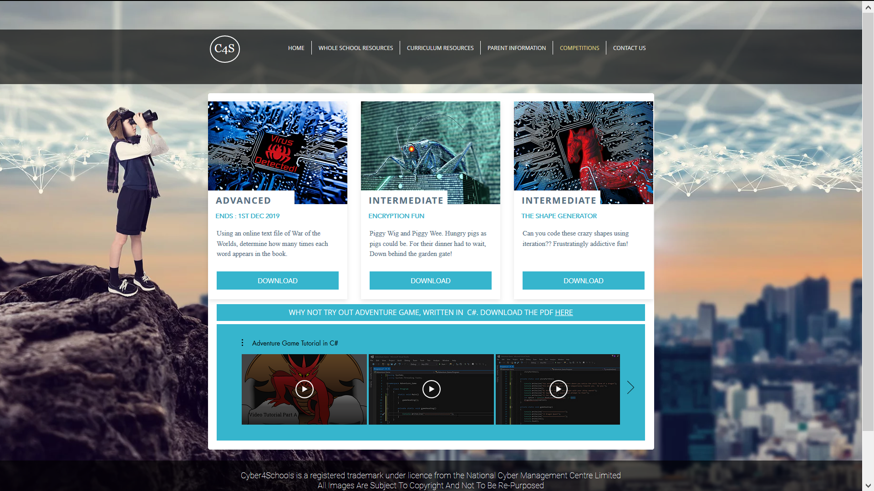
Notes:
Our website has a number of leaflets that link to interesting websites or free courses for children to go on.
We have some fun competitions for students to tackle and even a video tutorial showing them how to make a dungeons & dragons game in C#.
A great project for a coding club!

Slide 14
Cyber4schools.net
Notes:
We also have a referral process if you are worried and want to talk to us.
Remember, if we are asked to intervene we will work with whatever partners as deemed appropriate.
Our aim would be to reset the moral compass and then encourage the student to learn about these things in a safe and constructive manner.
Thank you for your time and patience.

