Slide 1
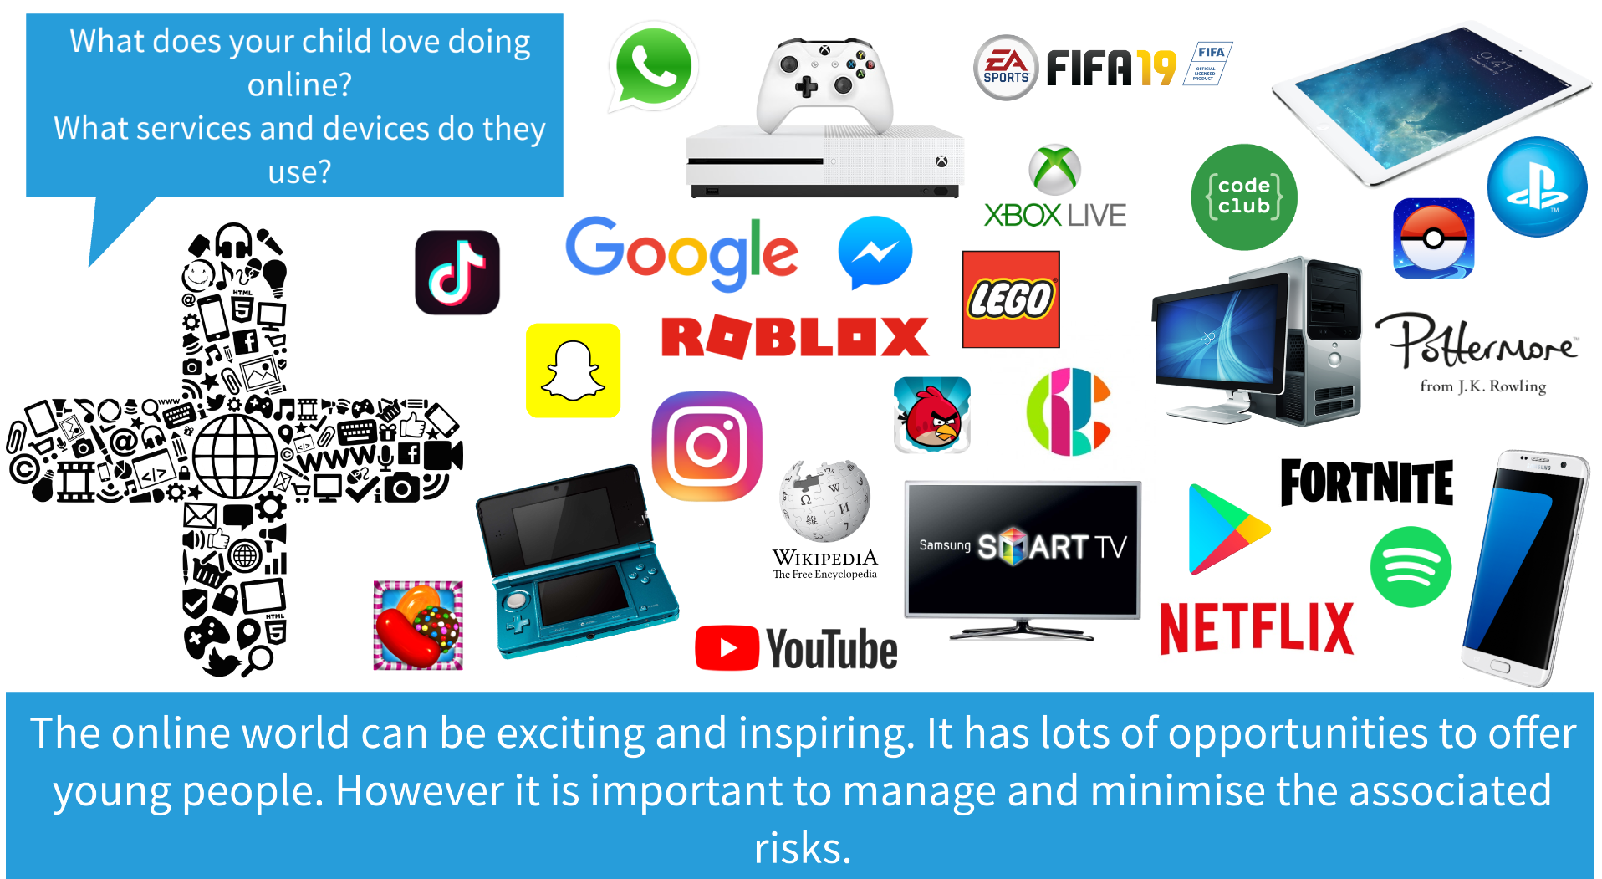

Slide 3
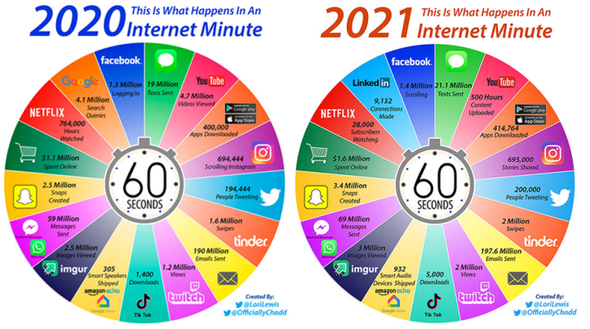

Slide 4
How great is
the internet?
Jamal Edwards

Slide 5
As of 2022, TommyInnit has an estimated net worth of £5 million at just 17 years old. ...

Slide 6
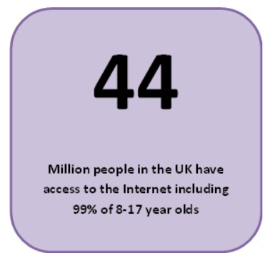
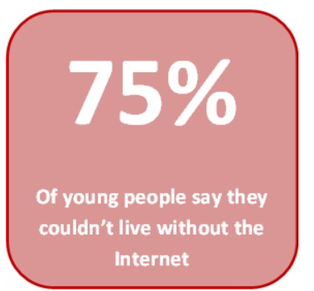
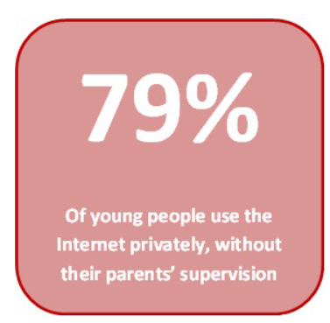
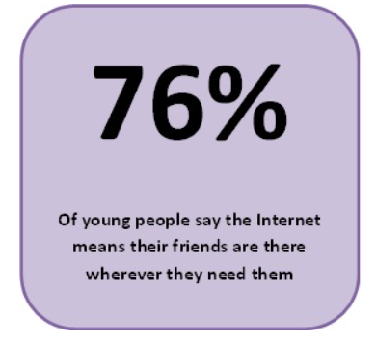
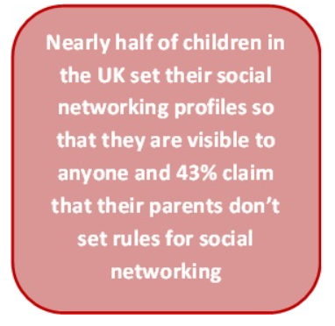

Slide 7
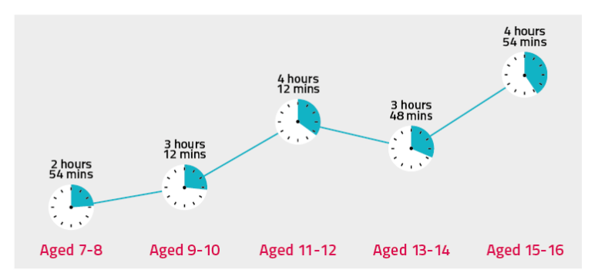

Slide 8
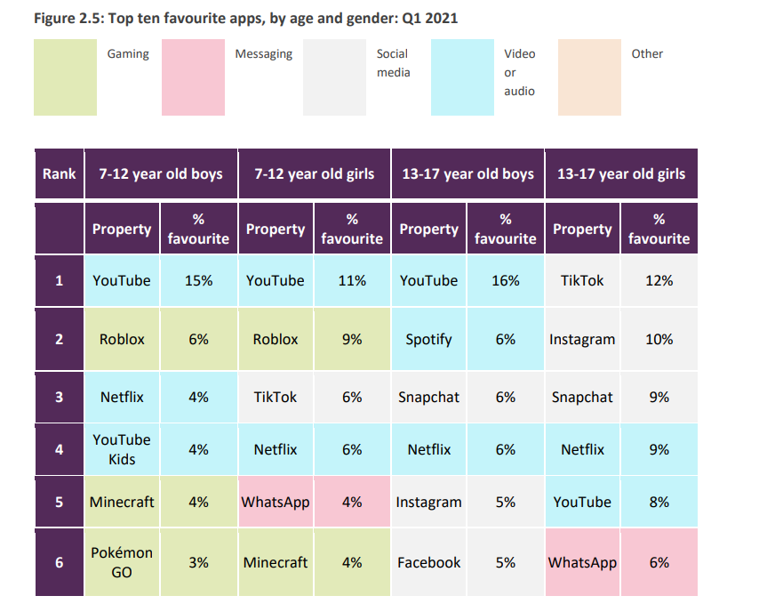
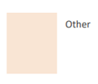
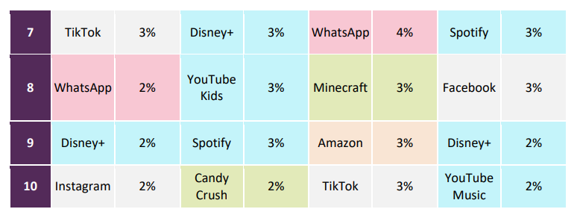

Slide 9
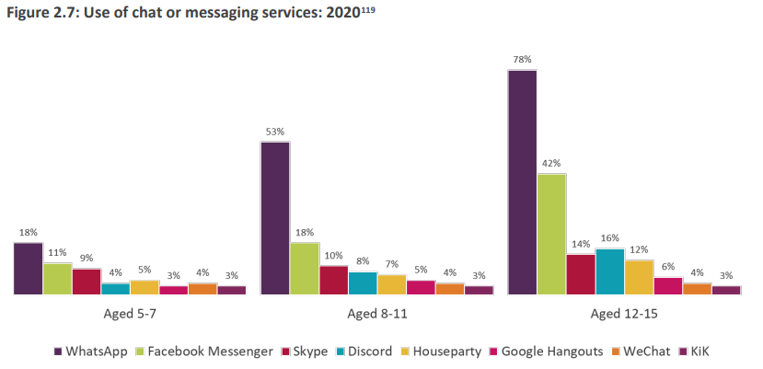
Three-quarters of children have a social media profile by age 12

Slide 10
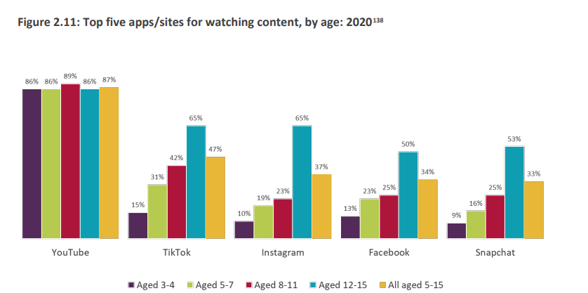

Slide 11
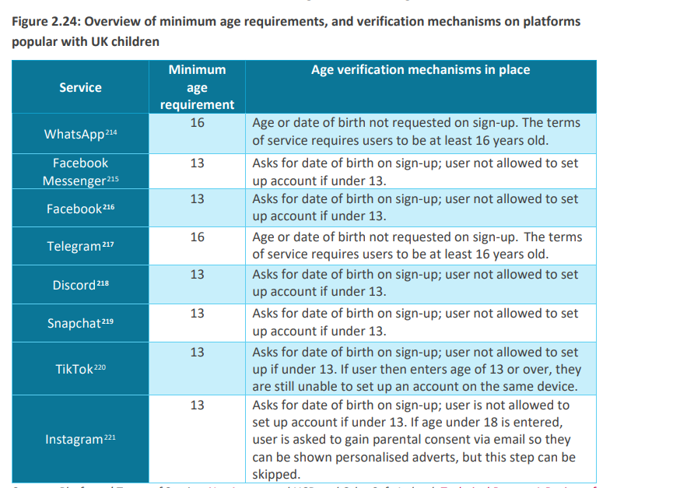

Slide 12
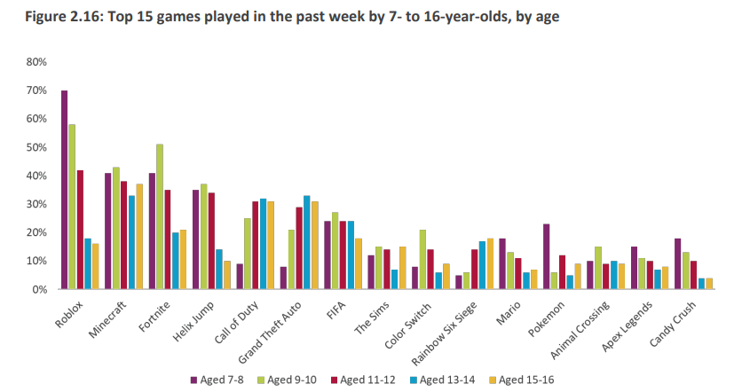

Slide 16
Commercialism
How does advertising on the web try to get your personal information?
How does YouTube get you to buy things?
How do games make you purchase things?
What is the purpose of an advert?
What do you do if they see a Pop Up?

Slide 17
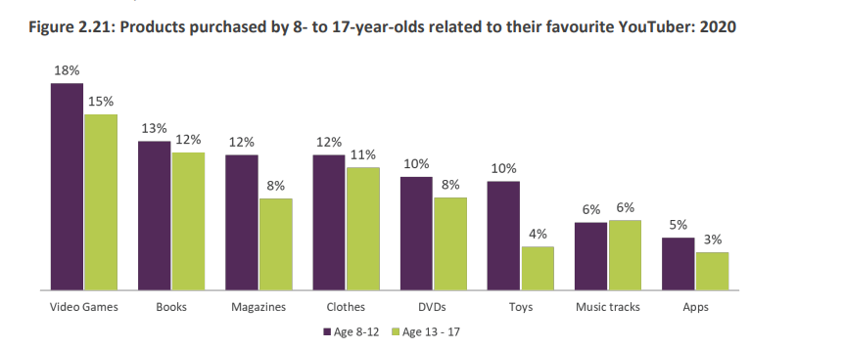
Children often do not fully understand how online advertising is tailored to their interests.

Slide 18
Digital Footprints
25 percent of kids are online in some fashion before they're even born.

Slide 19
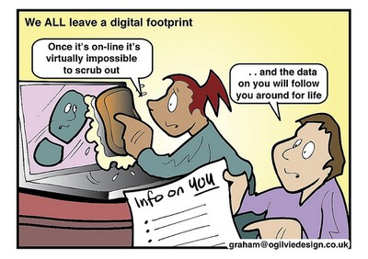
Digital Footprints
Job Interviews

Slide 20
Notes:
Ask the audience what they believe Cyberbullying to be and how/ where children and young people can be Cyberbullied? (Ask them to discuss in pairs and feedback to the group)
Play embedded film which was produced by CEOP
[Content below taken from a CEOP Cyberbullying factsheet, available for download]
“Cyber bullying is bullying that takes place via technology. Whether on gaming sites, through a mobile device or via a social networking site, the effects can be devastating for the young people involved.
With online technologies accessible 24 hours a day, cyberbullying can be relentless. It can also intrude on spaces that were previously personal, for example at home; it can feel that there is no escape from it.
21% of 8 to 11 year olds have been deliberately targeted, threatened or humiliated by an individual or group through the use of mobile phone or the internet and 28% of 11 – to 16 year olds.
Beatbullying, Virtual Violence II
The use of technology can increase the audience of the bullying and multiply the number of bullies involved, as young people re-post, send or ‘like’ bullying content. Bullies can also attempt to be anonymous which can extremely distressing for the victim. As hard as it can be to admit, it is also possible that your child is or has been a bully. They could have set up or joined a malicious profile or 'liked' a mean comment they have seen about someone online. They could be acting in this way due to peer pressure or in retaliation for something that has happened to them. When talking to your child about bullying it is important to let them know how you as a family feel about the act. Talk to them, about how it makes others feel and the consequences of their actions.”

Slide 21
A quarter of 8- to 11s who had experienced bullying said they had experienced it on social media.

Slide 22
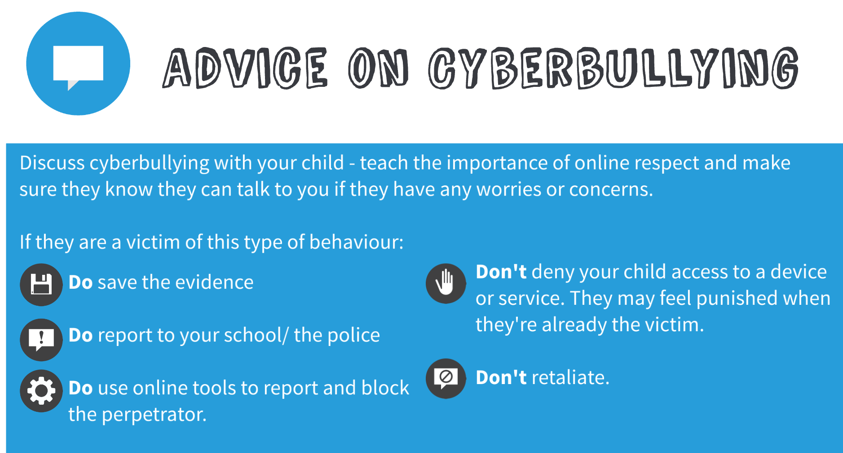
https://www.internetmatters.org/issues/cyberbullying/

Slide 23
https://www.internetmatters.org/issues/sexting/

Slide 24
Outcome 21
All incidents of youth produced sexual imagery should be recorded as a crime. However, in January 2016 the Home Office launched outcome 21. This allows police in England and Wales to record that a crime has happened but that it was not considered to be in the public interest to take formal criminal justice action. Crimes recorded under this code are unlikely to be disclosed on a vetting check in the future although this cannot be guaranteed. Decisions about using outcome 21 should be taken by a senior and/or experienced officer.
Outcome 21 may be a good solution in cases where:
a young person’s sexting was not abusive or persistent
there is no evidence of exploitation, grooming, profit motive or malicious intent (College of Policing, 2016).

Slide 25
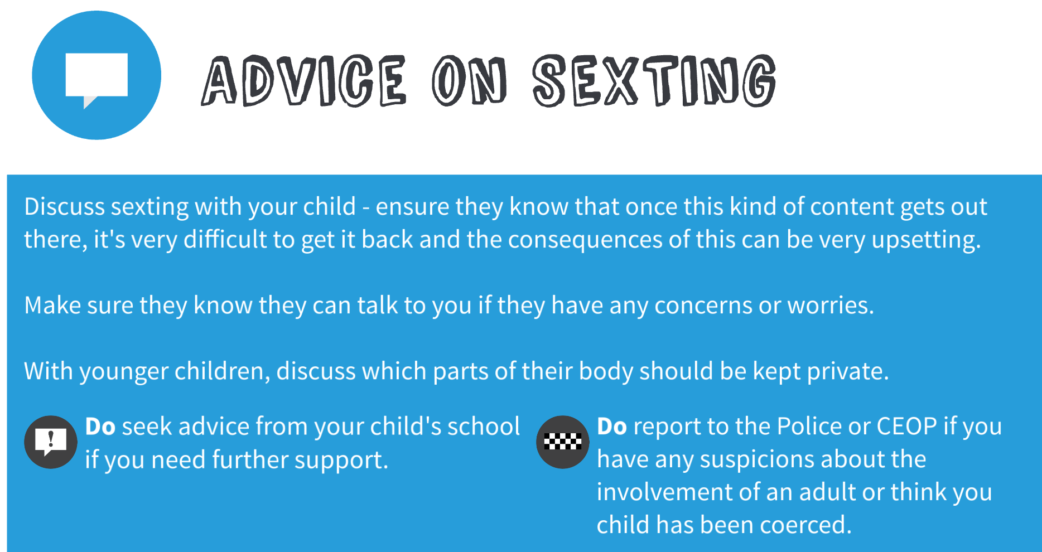

Slide 26
Grooming
Bribery
Flattery
Sexualised games
Threats
Blackmail
Desensitisation
https://www.internetmatters.org/issues/online-grooming/
Non-Contact sexual abuse can be defined as:
‘ When a child is used sexually by an adult or
young person…
When a child is pressurised, forced or tricked
into taking part in any kind of sexual activity’ NSPCC.

Slide 28
Friends
Children find it difficult to distinguish between an online friend and a real friend.
It is easy to lie online.
Not everyone is who they say they are!
The more friends you have, the more popular you are!

Slide 29
Friends
When chatting children and young people should remember:
Not to private chat with people they don’t know in the real world
Not to reveal personal information
How to block contacts
To put on privacy settings
How to save a chat log
Where to go if they are worried

Slide 30
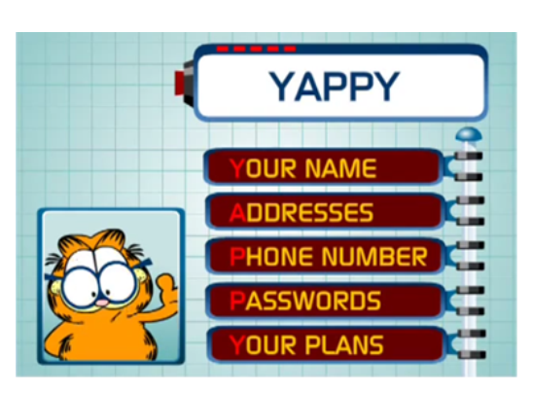
What is Personal
INFORMATION ?

Slide 32
If you left your child to their own devices, would they ever leave their devices?

Slide 34
https://www.childnet.com/parents-and-carers/have-a-conversation/

Slide 37
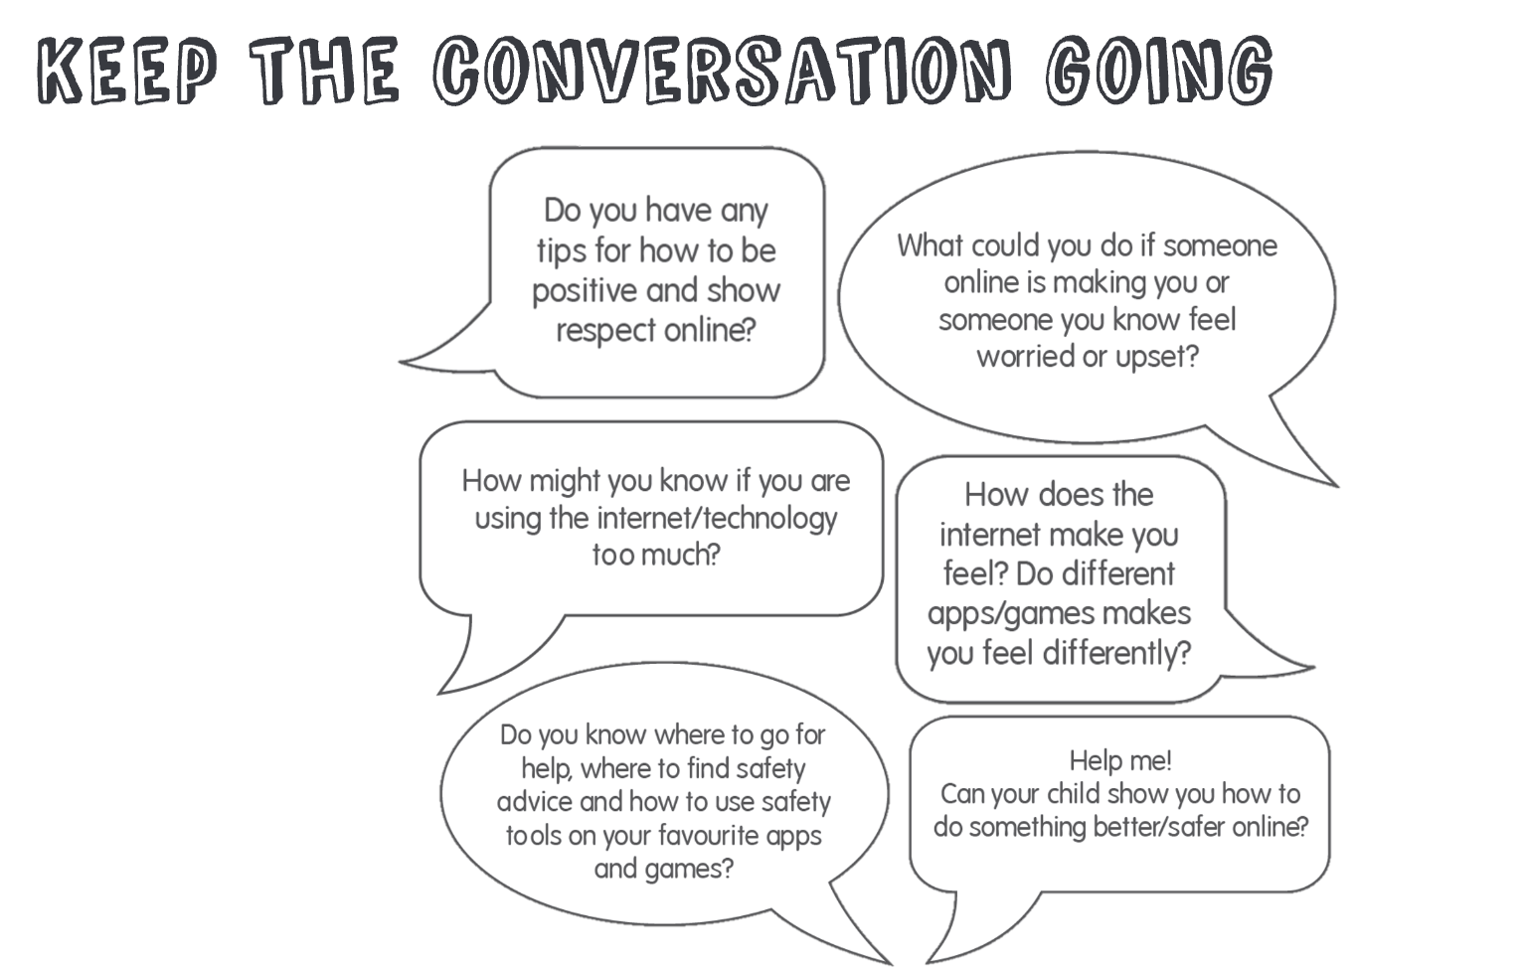

Slide 38
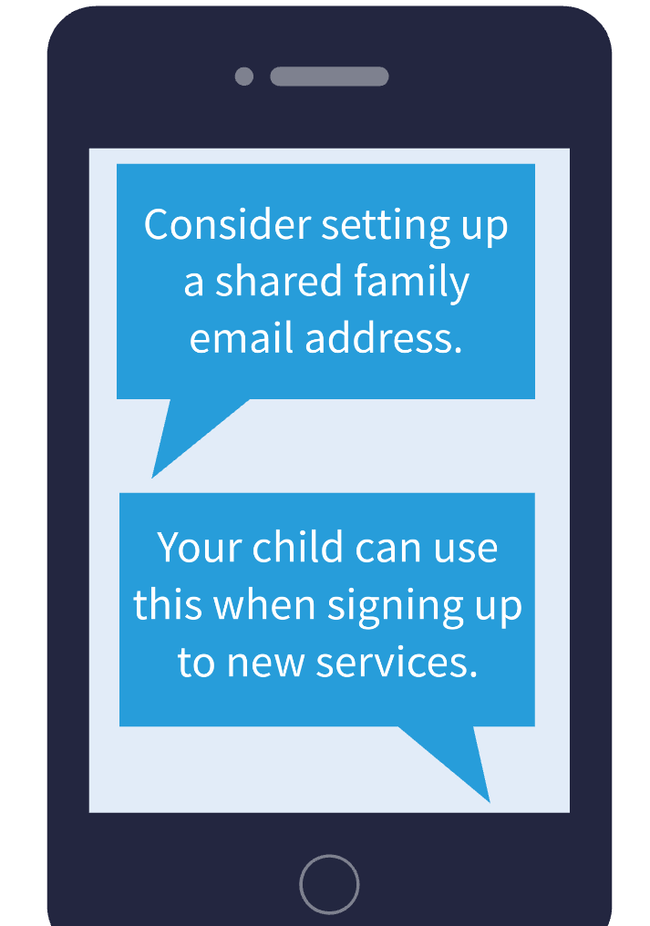

Slide 39
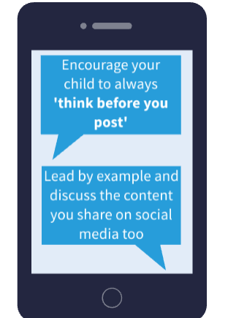

Slide 40
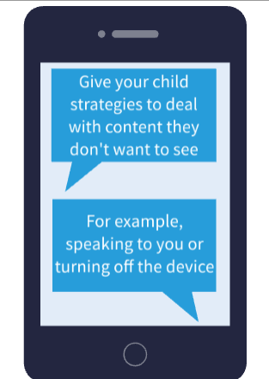

Slide 41
Digital Images
Ownership!
Asking permission first
Filters
Be aware of tags on photos that include information like date, time and location
Photos and videos can reveal more they you intend.
( School uniform, in front of your house)

Slide 42
Passwords
What makes a good password?

Slide 43
Gaming
Receiving messages from someone who was not who they said they were
Being encouraged to do something they would rather not do
Asking to meet up
Threats, name calling ,insults, sexual language
Exclusion
Griefing!
Distracted with game
Addiction
Bullying- games can be highly competitive
Commercial pressures
Gaming Tag/Username
Pegi Ratings and content guide

Slide 44
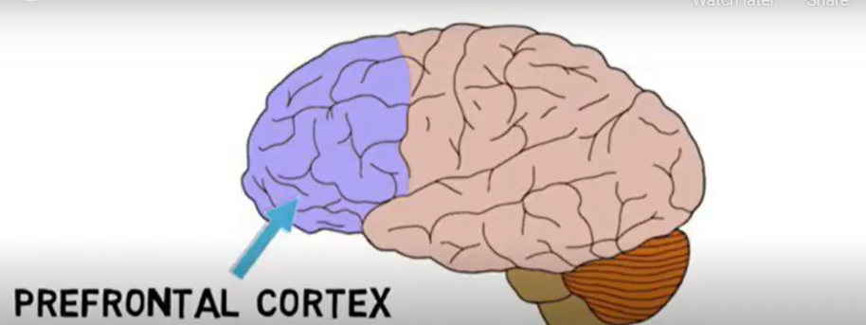
Gaming
The frontal cortex of the brain enables you to make sense of the world and make judgements about your own behaviour and the behaviour of others. The ability to differentiate between reality and fantasy is not fully developed until early adulthood!

Slide 45
Gaming
The frontal cortex of the brain is the part that deals with fear, emotional responses and behavioural responses.
A child’s brain is also not developed enough to process the fast moving images.

Slide 47
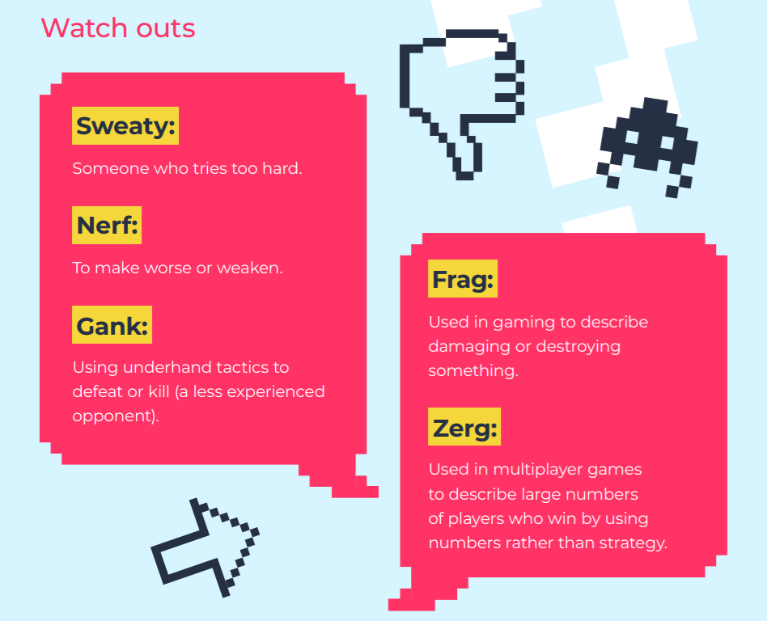

Slide 48
Location
An increasing number of services take advantage
of the GPS tracking capabilities of mobile phones.
Social networking services now enable you to share
your exact location.
Be aware of tags on photos that include information
like date, time and location.

Slide 49
Fake news and
misinformation
https://www.internetmatters.org/issues/fake-news-and-misinformation-advice-hub/

Slide 50
Inappropriate
content

Slide 51
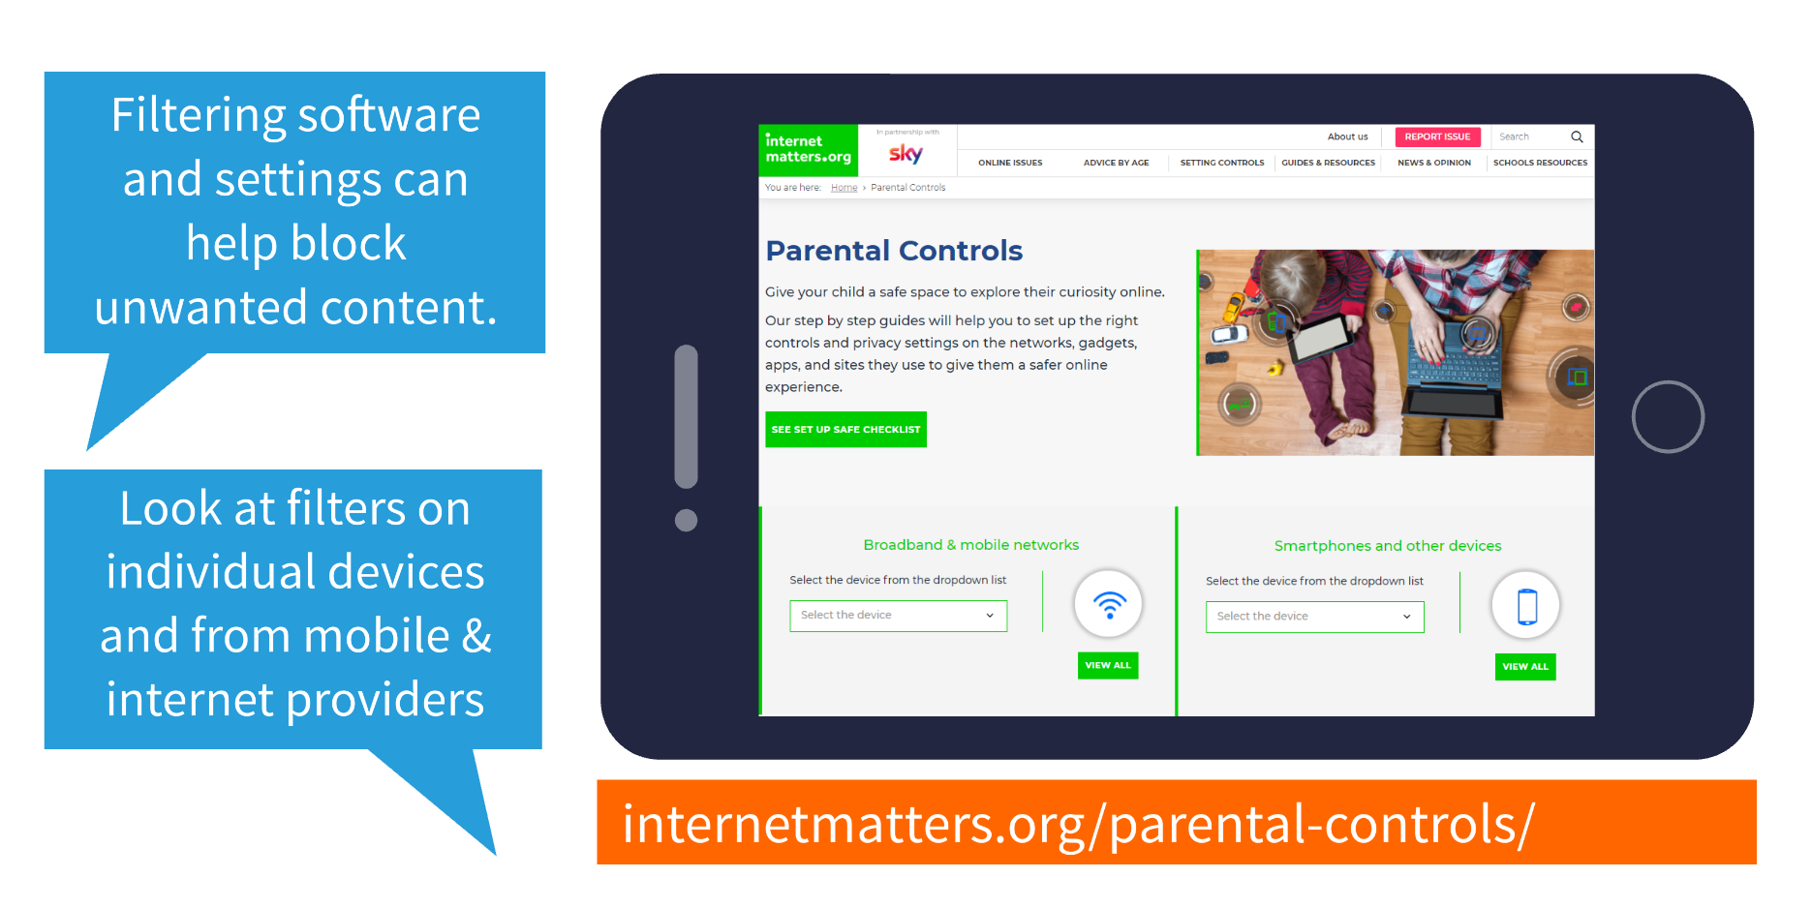
https://www.internetmatters.org/parental-controls/?gclid=EAIaIQobChMIku-S-MP_9QIVBurtCh3FjwdYEAAYASABEgLlZfD_BwE

Slide 52
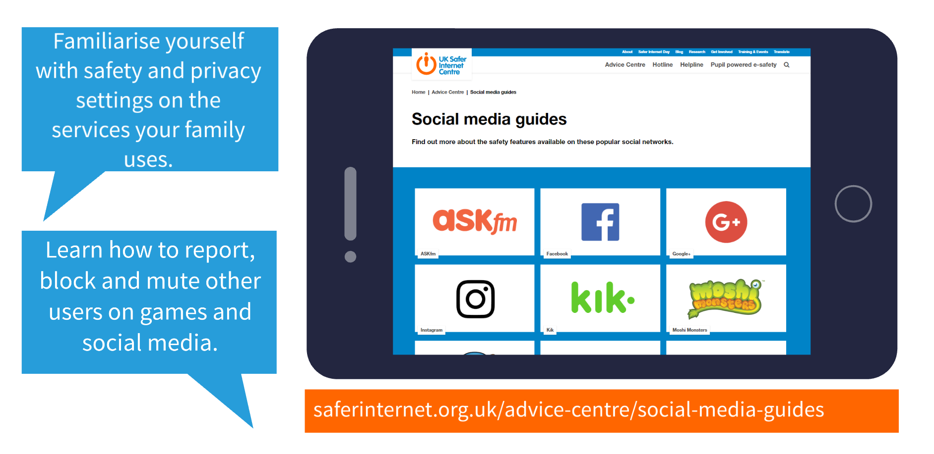
https://www.internetmatters.org/parental-controls/social-media/

Slide 53
But, even with filters in place, children may still encounter content that concerns them. Establish
a ‘no blame’ culture so your child feels they can talk to you.

Slide 54
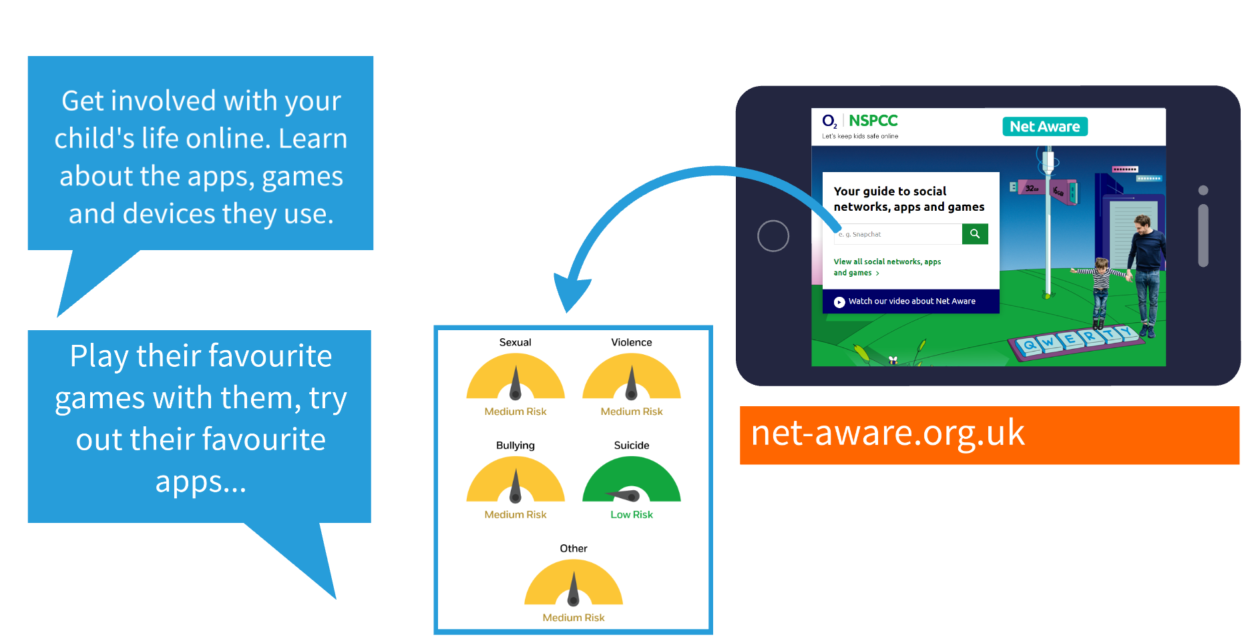

Slide 56
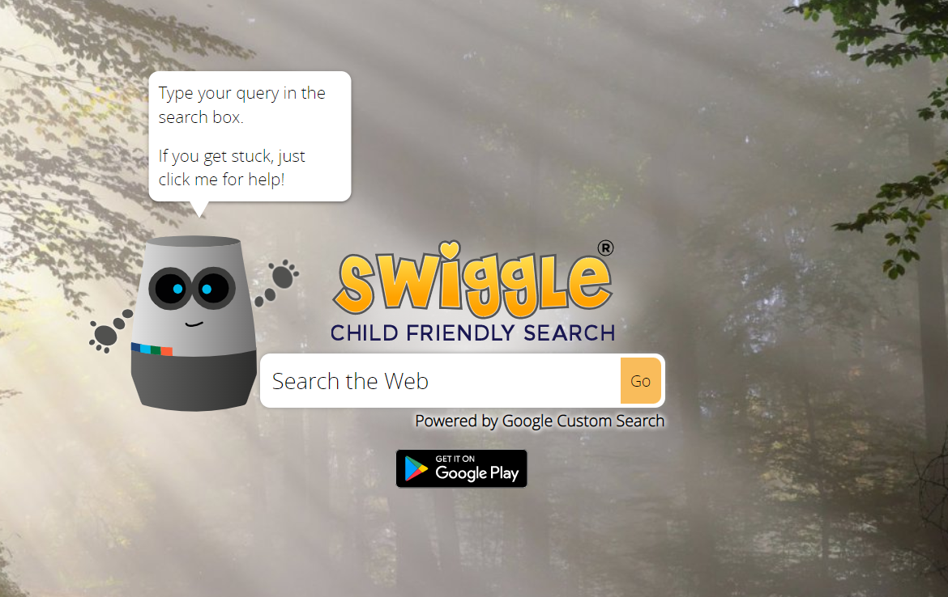
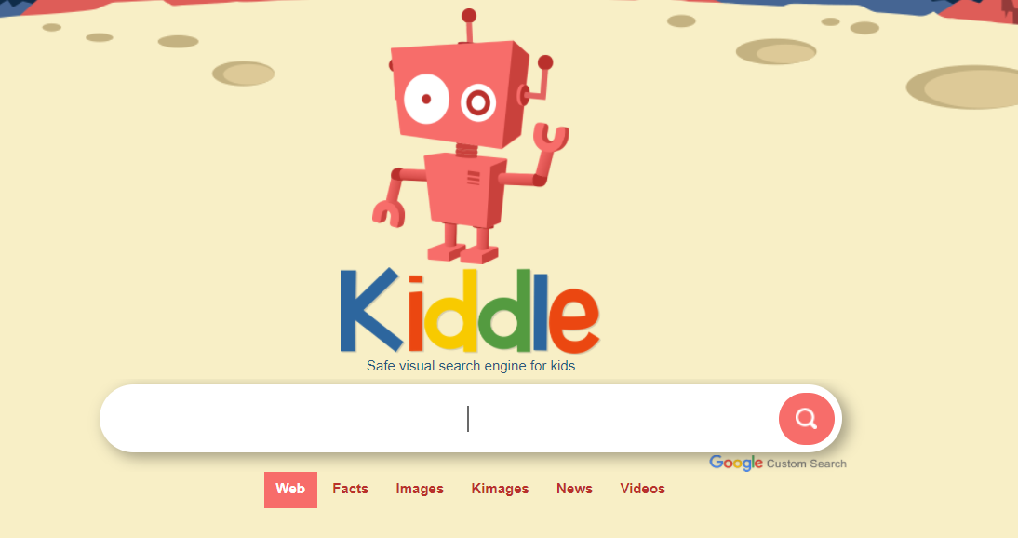
Child friendly search engines

Slide 57
Copyright free images

Slide 58
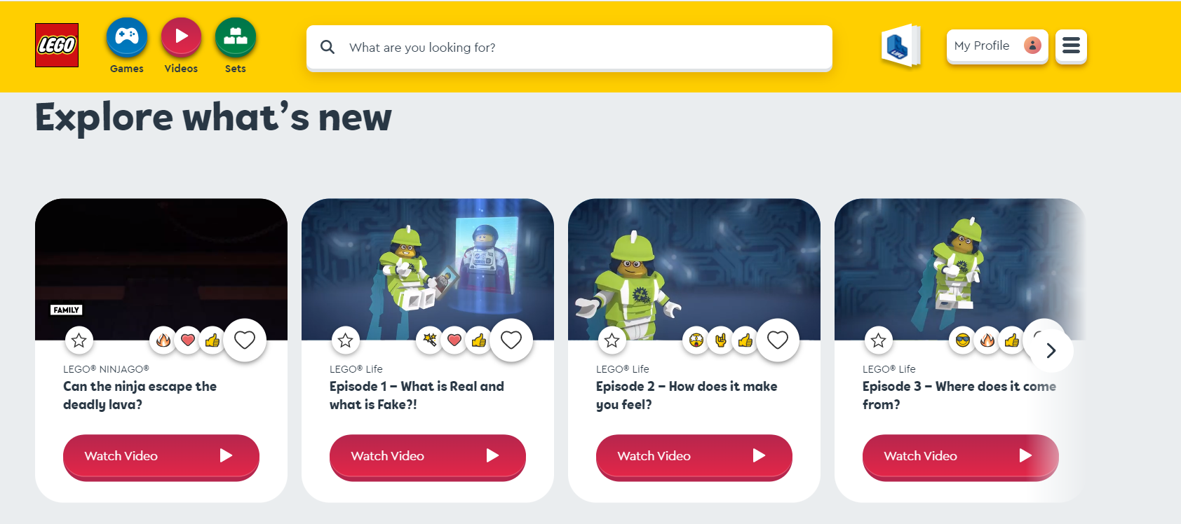
https://www.lego.com/en-gb/kids

Slide 59
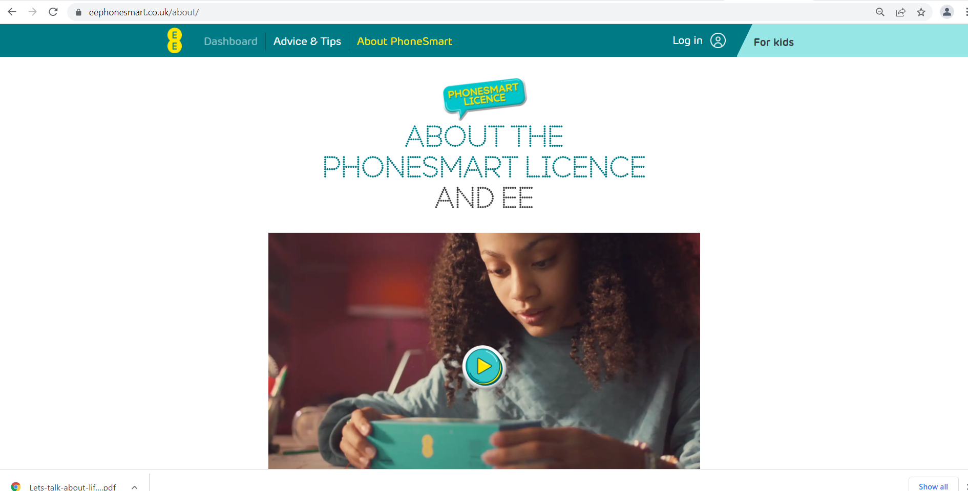
https://eephonesmart.co.uk/about/

Slide 60
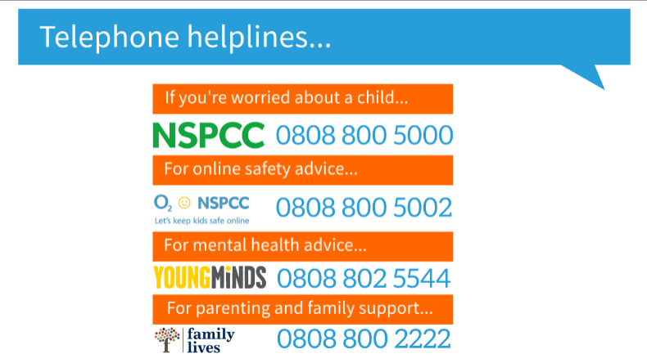

Slide 62
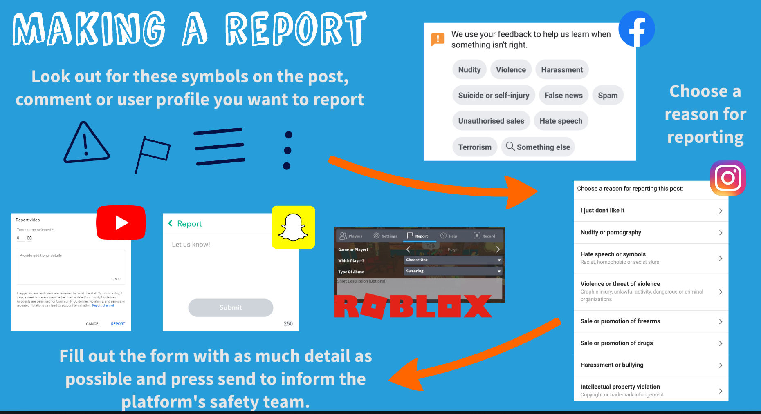

Slide 66
Our Website

