Slide 2
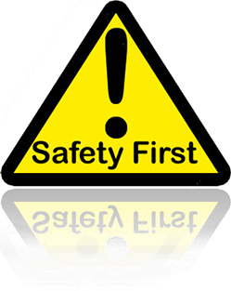
…online safety
Made by sam

Slide 3

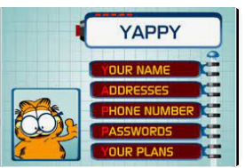
Yappy
Yappy is a bunch of rules to make a word and those rules are for online safety.

Slide 4

Y
The Y stands for your name which is not to share with some one you don’t know.

Slide 5

a
The A stands for addresses which you never tell anyone.

Slide 6

p
Now the P it stands for phone number which you only EVER tell to the people you know and trust.

Slide 7

P.2
But hold up that isn’t the end there is a second P
And this one stands for passwords
which only you should ever know.

Slide 8
y.2
And finally the 2nd Y which this last little one stands for your plans this one you never ever tell any one but your family. Because you never know you could tell them and they could end up there and ruin it. So if you listen it’s up to you

Slide 9
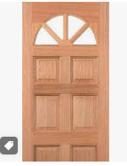


Good password
Lion.daisy.door. Three random words

Slide 10

But there is a couple other things you need to know FAIR USE AND PUBLIC DOMAIN these 2 things are really important to the internet they make sure whatever you put on the internet is safe.

Slide 11

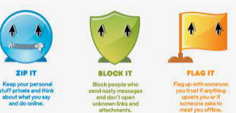
Zip it block it flag it
Zip it. Keep your personal stuff private and think about what you say online.

Slide 12

Block it
Block it. Block people who send nasty messages and don’t open unknown links

Slide 13

Flag it
Flag it. Flag up with someone you trust if anything upsets you or if someone asks to meet you offline

Slide 14
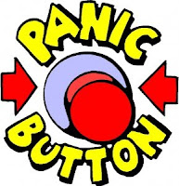

Click ceop
Click ceop it’s telling you to tell someone you trust

Slide 15

As long as you listen to those fact full rules your will know how to be safe online
P.S thank you ☺.

